Slide 1


NBN Sinhgad School Of Engineering -SPPU (Pune) (Information Technology)
Project Based Seminar Presentation
On
“Social Distance Analyzer”
Presented By :-
Shivam Vinod Verma (T.L)- T151058568 Mahesh Bhausaheb Nagare - T151058551 Bipin Kiran Patil - T151058555 Nikhil Yogesh Chapne - T151058515
Under Guidance - H.O.D Prof. R.M Samant Sir
(I.T, NBNSSOE, Pune)

Slide 2
Content :-
1. PROJECT DETAILS | 8. Introduction | 15. Flow & UML Diagram
2. MOTIVATION | 9. Importance | 16. Working Module
3. AIM | 10. Scope | 17. Project Plan
4. Roles Of Member | 11. Requirement | 18. Project Schedule
5. ABOUT PROJECT | 12. Libraries Required | 19. Implementation & Demo
6. Domain | 13. Proposed Methodology | 20. Conclusion
7. Abstract | 14. Proposed System | 21. References

Slide 3
PROJECT DETAILS
PROJECT TITLE - | “Social Distance Analyzer”
PROJECT DOMAIN - | “Artificial Intelligence” & “Machine Learning”
PROJECT GROUP MEMBERS - | Shivam Vinod Verma (T.L)- T151058568 Mahesh Bhausaheb Nagare - T151058551 Bipin Kiran Patil - T151058555 Nikhil Yogesh Chapne - T151058515

Slide 4
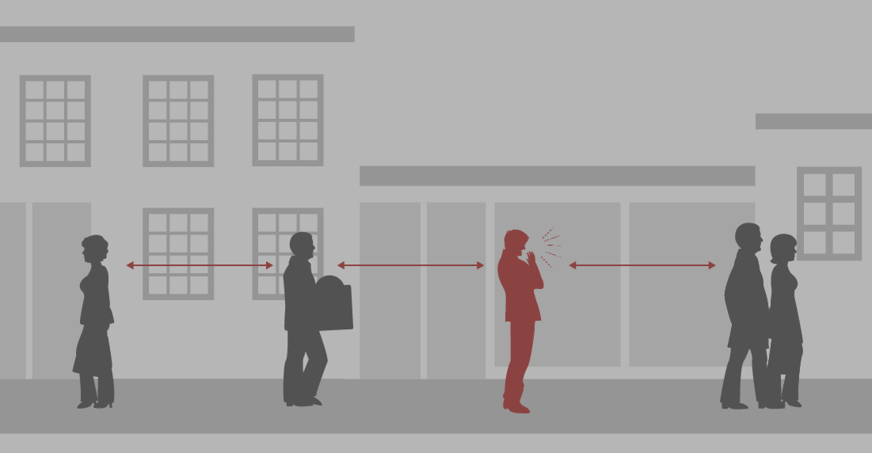
MOTIVATION -
This pandemic situation has forced every corner of the world to shut down due to Covid-19 virus. Since March 2020 after every month duration of 3-4 months we are being affected by its new strain causing fresh waves. India is expecting its 3rd wave soon.
Shutting everything down affects every sector from economy to education. This pandemic situation will further go for next few coming years & to avoid getting infected the only norm is Maintaining Social Distance.
When we talk about public places then it is really hard to keep an eye in the public & maintain social distance. So seeing this situation we thought of developing this project through which we can easily track down distance between people at public places like airports, railway station, college canteen , office, society entrance etc.
This development will be boon for society through which maximum of sectors will not be forced to shut down & surely there will be reduction in no. of covid-19 cases.

Slide 5
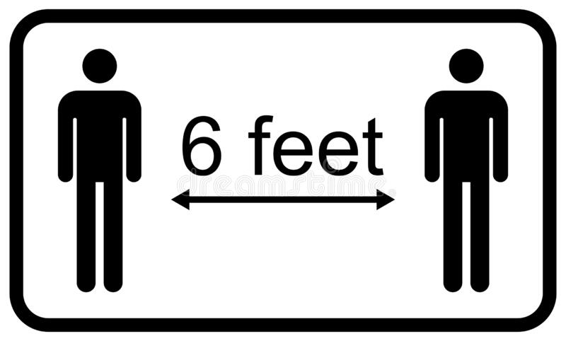
AIM :
To develop a technology that may trace whether the social distancing rules are obeyed or not.
To control any outspread of any future contagious disease.
To develop a Privacy-friendly software.
To Preserve the work continuity while also keeping the people safe.
To Increase confidence in people moving in public places.

Slide 6
Role Of Members -
“Social Distance Analyzer”
Shivam Vinod Verma - Developer, Documenter & Analyzer
Mahesh Bhausaheb Nagare - GUI Designer & Tester
Bipin Kiran Patil - Working , Algorithm Designer & Tester
Nikhil Yogesh Chapne - Developer.

Slide 7
ABOUT THIS PROJECT
This project is focusing on surveillance of public places and detecting whether the people are maintaining social distancing or not. Social Distancing is the only best option for us to protect ourselves from diseases.
The project uses the development of a technology through use of AI based procedures to detect whether the social distancing norm is followed or not.
In this proposed system Computer Vision and deep learning techniques are also used.

Slide 8
Domain
“Artificial Intelligence” It is the simulation of human intelligence in machines that are programmed to think like humans and mimic their actions. Eg :- Manufacturing robots, Self-driving cars, Smart assistants etc. | “Machine Learning” Data analysis that automates analytical model building. It is branch of artificial intelligence based on the idea that systems can learn from data, identify patterns and make decisions with minimal human intervention. Eg :- Image recognition, Speech recognition, Google Maps etc.

Slide 9
Abstract
The COVID-19 virus spreads among the people who are in close contact for a long period. Chances of
spreading a virus is more when a person who is infected with the virus sneezes, coughs or talks near other.
It is very important for us to stay at least 6 feet or 2 meters away from other people even if you or they do not have any symptoms. Social distancing is the best method to be followed to reduce the spread of the virus. People are informed to avoid contact with other people, thereby controlling the spread of the virus
Artificial Intelligence and Deep Learning has shown good results on some daily life problems. In this proposed system Computer Vision and deep learning techniques are used to monitor social distancing between people at public places.
The framework uses the YOLOv3 object recognition paradigm to identify humans in video sequences. The transfer learning methodology is also implemented to increase the accuracy of the model.
In this way, the detection algorithm uses a pre-trained algorithm that is connected to an extra trained layer using an overhead human data set. The detection model identifies peoples using detected bounding box information. Using the Euclidean distance, the detected bounding box centroid's pairwise distances of people are determined.
Accuracy of 92% and 98% achieved by the detection model without and with transfer learning, respectively.
The tracking accuracy of the model is 95%

Slide 10
Introduction
The pandemic situation has created problems all over the world and has made the conditions worse, as of now social distancing has become one of the best methods to prevent the spread of COVID-19.
Monitoring public places, this provides a promising solution. Using CCTV and drone footages human activities can be tracked at public places and also helps in monitoring the social distancing between people. This system can help in detecting whether the social distancing is maintained or not between the people and will be useful all around the world.
With the help of CCTV footages we can monitor people and calculate the distance between the people using deep learning techniques and set the standard distance of 6 feet to be maintained between people and to detect people who violates the law.
Helps in minimizing the contact between infected people and healthy people. The objective is to reduce the spread of the virus, thereby helping in declining the size of the epidemic peak, and helping the healthcare systems. This approach uses object detection and tracking techniques to control overcrowding. This project is focusing on surveillance of public places and detecting whether the people are maintaining social distancing or not.
To make sure that social distancing guidelines is followed in public places and workplace, the social distancing detection system can be used to monitor people whether they are maintaining safe distance of at least 6 feet from each other.

Slide 11
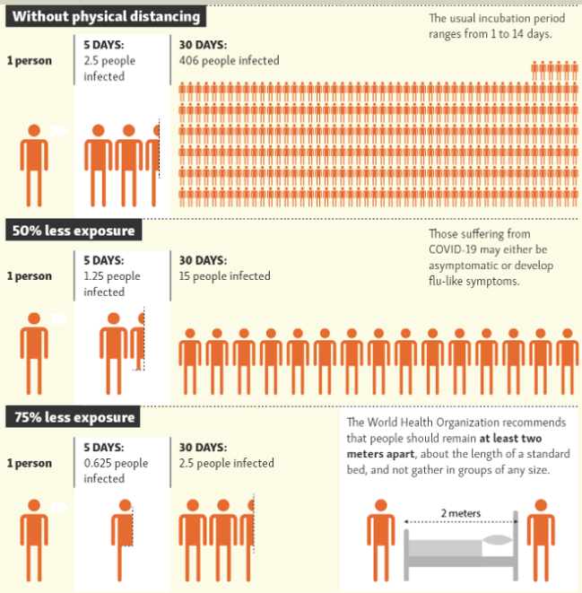
Importance :
Without Physical distance, also known as Social Distance if one infected individual transmits virus to an average 2.5 people, then they 2.5 infected person will transmit virus to another 2.5 people and so on just within a month in total of 406 people would be infected by just a single infected person.
Son that’s why maintaining social distance is must.

Slide 12
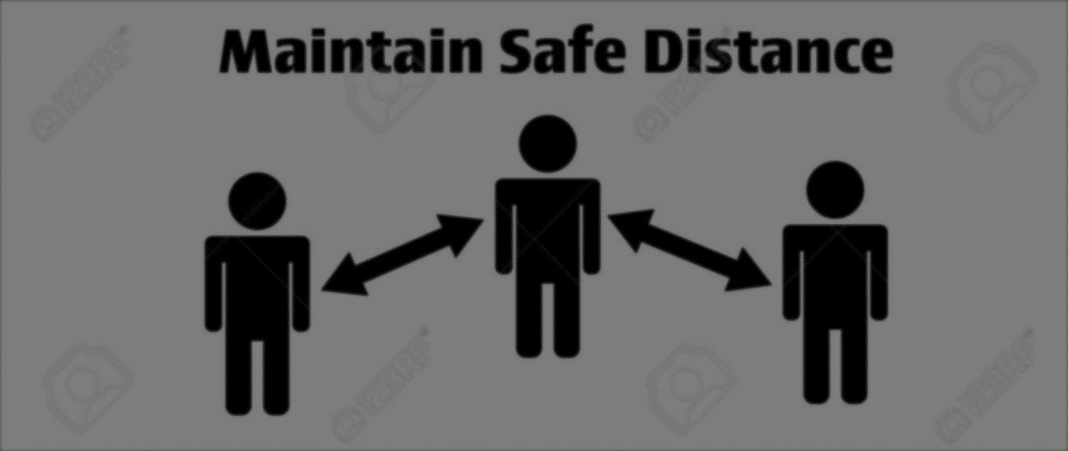
Scope
This project is focusing on surveillance of public places and detecting whether the people are maintaining social distancing or not. Social Distancing is the only best option for us to protect ourselves from diseases, not limited to COVID-19, where no medicinal antidote has been prepared, and that may be transmitted through human contact. The project uses the development of a technology through use of AI based procedures to detect whether the social distancing norm is followed or not, in any public video stream. The software embedded can distinguish between a person maintaining social distance (marked green) and a person who is not (marked red). We will also keep a count of incidents where social distancing was not followed.

Slide 13
REQUIRMENTS
SOFTWARE Software :- Anaconda + Python 3.x Editor :- VS Code/ PyCharm/ Sublime/ Spyder Environment :- TensorFlow GPU Drivers :- Nvidia® CUDA® or above CUDA® Toolkit | HARDWARE GPU :- Graphics Processor (NVIDIA) min 2GB Camera :- CCTV/ Webcam/ Mobile Camera Storage Disk (Optional) :- SSD – Min 400MB/s Read Speed | Librarie Required Deep Learning Computer Vision OpenCV Yolo Object Detection Python Image Processing Artificial intelligence Machine learning

Slide 14
Libraries Required :
Deep Learning
Computer Vision
OpenCV
Yolo Object Detection
Python
Image Processing
Artificial intelligence
Machine learning
Deep Learning :- It is a subset of machine learning in artificial intelligence that has networks capable of learning unsupervised from data that is unstructured or unlabeled.
Computer Vision :- It is a field of artificial intelligence that trains computers to interpret and understand the visual world. Using digital images from cameras and videos and deep learning models, machines can accurately identify and classify objects.
OpenCV :- It is a cross-platform library using which we can develop real-time computer vision applications. It mainly focuses on image processing, video capture and analysis including features like face detection and object detection.
YOLO :- It is a clever convolutional neural network (CNN) for doing object detection in real-time. The algorithm applies a single neural network to the full image, and then divides the image into regions and predicts bounding boxes and probabilities for each region.
Python :- It is a general-purpose coding language—which means that, unlike HTML, CSS, and JavaScript, it can be used for other types of programming and software development besides web development.
Image Processing :- It is a method to perform some operations on an image, to get an enhanced image or to extract some useful information from it.
Artificial intelligence :- It refers to the simulation of human intelligence in machines that are programmed to think like humans and mimic their actions.
Machine learning :- It is a method of data analysis that automates analytical model building. It is a branch of artificial intelligence based on the idea that systems can learn from data, identify patterns and make decisions with minimal human intervention.

Slide 15
Proposed Methodology
The steps for building a social distancing detector tool are :-
1. Apply object detection to detect all the people in an image or video stream.
2. Pairwise distances are computed between each detected person.
3. Based on the distance computed, check whether two people are less than N pixels apart.
Process :
1. An image is given as an input to the system to detect people. The YOLO algorithm splits the image into grids and assigns the bounding box to the grids that contain the midpoint of the object to be detected. Intersection Over Union is performed to know whether the predicted bounding box is correct or not.
2. Then if a single object is detected more than once, a non-max suppression method is used that chooses the bounding box that has the highest probability and then eliminates the remaining bounding boxes that are close by performing IoU. After bounding box is obtained for each detected object, we then calculate the centroid for each bounding box.
3. Then perspective transformation or bird eye view transformation is applied which gives a top view of the centroids. This transformation makes the distance calculation between the centroids easier. Then we calculate the distance between the centroids. If the distance is greater than the mentioned distance in the program, the bounding box turns green, else the bounding box turns red.

Slide 16
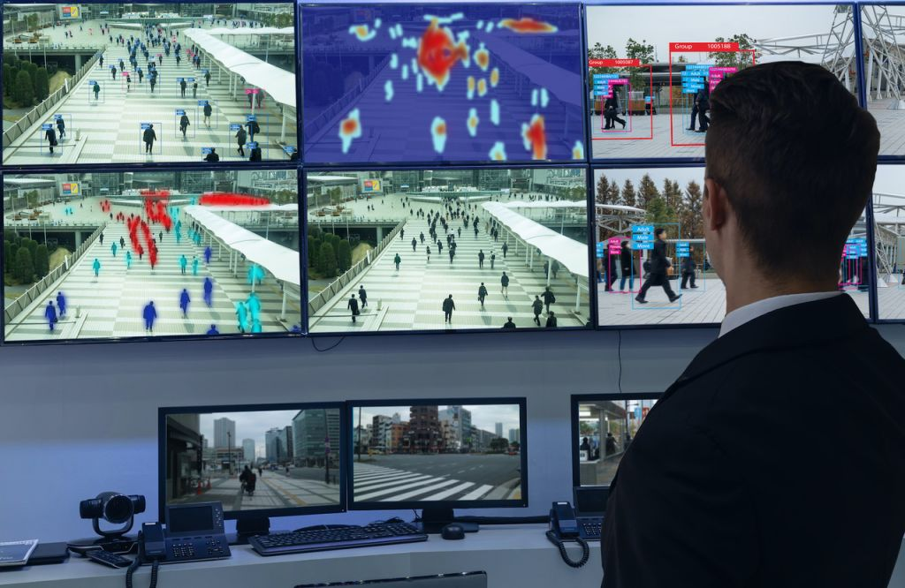
1. Detect people in the frame using yolov3.
2. Calculating centroids of each detected person.
3. Perform perspective transformation of detected people.
4. Calculate the distance between centroids of each person detected in the frame.
5. Shows whether social distancing is maintained or not.
Proposed System :
The system that is proposed focuses on how to identify the person in the image or video stream and to detect whether the social distancing is maintained or not using computer vision and deep learning techniques and object detection algorithms like YOLO algorithm. The approach for this model is:

Slide 17
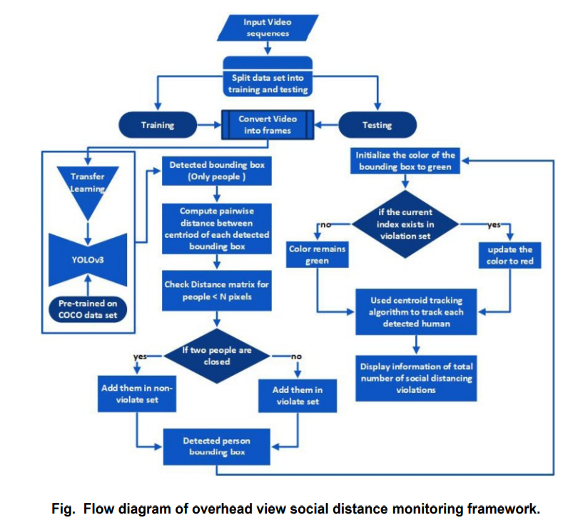
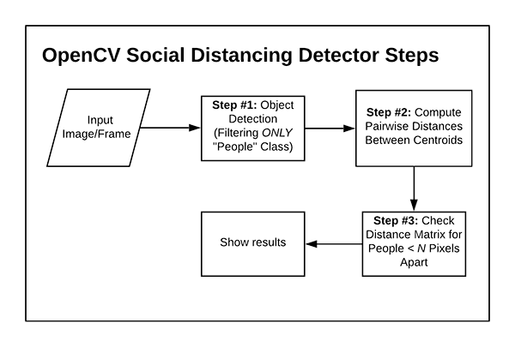
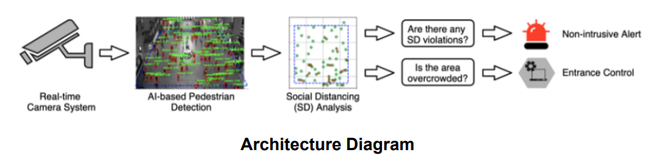
Flow & UML Diagram

Slide 18
Working Module
An image is given as an input to the system to detect people. The YOLO algorithm splits the image into grids and assigns the bounding box to the grids that contain the midpoint of the object to be detected.
Intersection Over Union is performed to know whether the predicted bounding box is correct or not. Then if a single object is detected more than once, a non-max suppression method is used that chooses the bounding box that has the highest probability and then eliminates the remaining bounding boxes that are close by performing IoU.
After the bounding box is obtained for each detected object, we then calculate the centroid for each bounding box. Then perspective transformation or bird eye view transformation is applied which gives a top view of the centroids.
This transformation makes the distance calculation between the centroids easier. Then we calculate the distance between the centroids.
If the distance is greater than the mentioned distance in the program, the bounding box turns green, else the bounding box turns red.

Slide 19
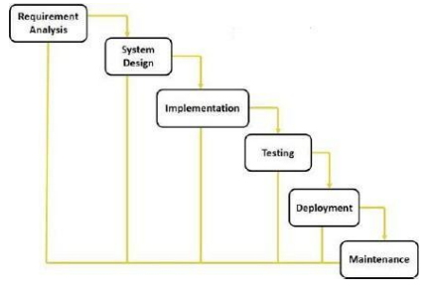
Project Plan
The waterfall model is a sequential design process, used in software development processes, in which progress is seen as flowing steadily downwards (like a waterfall) through the phases of conception, initiation, analysis, design, construction, testing, production maintenance. Waterfall approach was the first SDLC Model to be used widely in Software Engineering to ensure success of the project.

Slide 20
1. Requirement Gathering and Analysis : - All possible requirements of the system to be developed are captured in this phase and documented in a requirement specification doc.
2. System Design :- The requirement specifications from first phase are studied in this phase and system design is prepared. System Design helps in specifying hardware and system requirements and also helps in defining overall system architecture.
3. Implementation :- With inputs from system design, the system is first developed in small programs called units, which are integrated in the next phase. Each unit is developed and tested for its functionality which is referred to as Unit Testing.
4. Integration and Testing :- All the units developed in the implementation phase are integrated into a system after testing of each unit. Post integration the entire system is tested for any faults and failures.
5. Deployment of system :- Once the functional and non-functional testing isdone, the product is deployed in the customer environment or released into the market.
6. Maintenance :- There are some issues which come up in the client environment. To fix those issues patches are released. Also to enhance the product some better versions are released. Maintenance is done to deliver these changes in the customer environment.

Slide 21
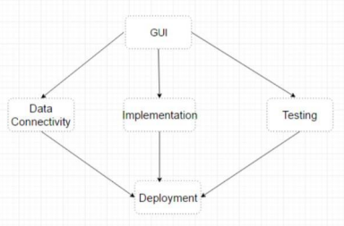
Project Schedule
1.
Communication
2.
Planning
3.
Design
4.
Construction
5.
Deployment

Slide 22
Implementation
This development can be easily installed at various public places like Offices, College canteens, Airports, Railway Stations, Society’s etc.
We just need to attach the developed software with CCTV installed in the respective area which we want to track. Within couple of minutes it will start giving accurate results. It can also be attached with drones.
Pretrained SSD will detect faces & Euclidean distance will calculate social distancing violations. It is very easy to install.
If we want to install this in too crowded areas then it is possible there also by just attaching the software with all the possible CCTV’s around. For sure implementing this will show fall in daily covid-19 cases & it will help in bringing back normality soon.
Versions of this software are already installed in some airports of India & it has shown great help in tracking Social Distancing between people.
Through public announcements people who are not following norms can be alerted if found violating rules.

Slide 23
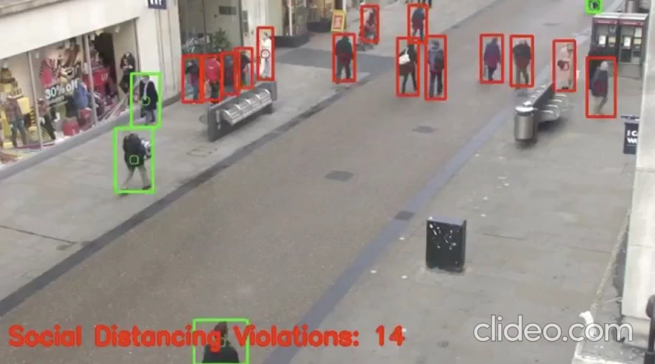
DEMO

Slide 24
Conclusion :
As we picture the world after COVID-19 pandemic the need of self-responsibility should be developed among the people. The world would focus on accepting the precautions and guidelines provided by WHO.
The responsibility of an individual depends completely on themselves and not on the government. Social Distancing will be the important factor to reduce the spread of the virus. To control huge crowd, an effective solution is needed and in our project we mainly focus on that.
Using Camera or CCTV footages, the authorities can monitor people and can also control overcrowding in any events and thus helps in maintaining social distance.
If people maintain a safe distance of at least 6 feet they would be indicated with green boundary box, and if not red.

Slide 25
References
1. Savyasachi Gupta, Rudrakshi Kapil, Goutham Kanahasabai, Shreyas Srinivas Joshi, Aniruddha Srinivas Joshi “SD-Measure: A Social Distancing Detector”, IEEE, 2020.
2. Pias,“Object detection and distance measurement,” https://github.com/ paul-pias/Object-Detection and Distance-Measurement, 2020
3.Y. Xu, J. Dong, B. Zhang, and D. Xu, “Background modelling methods in video analysis: A review and comparative evaluation,” CAAI Transactions on Intelligence Technology, vol. 1, no. 1, pp. 43–60, 2016 & S. Ren, K. He, R. Girshick, and J. Sun, “Faster r-can : Towards real-time object detection with region proposal networks,” in Advances in neural information processing systems, 2015, pp. 91–99.
4. A. Krizhevsky, I. Sutskever, and G. E. Hinton, “ImageNet classification with deep convolutional neural networks,” in Advances in neural information processing systems, 2012, pp. 1097– 1105.
5.P. Dollar, V. Rabaud, G. Cottrell, and S. Belongie, “Behaviour recognition ´ via sparse spatio-temporal features,” in 2005 IEEE International Workshop on Visual Surveillance and Performance Evaluation of Tracking and Surveillance. IEEE, 2005, pp. 65–72 & M. Piccardi,“Background subtraction techniques: a review,” in 2004 IEEE International Conference on Systems, Man and Cybernetics (IEEE Cat. No. 04CH37583), vol. 4. IEEE, 2004, pp. 3099–3104[13] H. Tsutsui, J. Miura, and Y. Shirai, “Optical flowbased person tracking by multiple cameras,” in Conference Documentation International Conference on Multisensor Fusion and Integration for Intelligent Systems. MFI 2001 (Cat. No. 01TH8590). IEEE, 2001, pp. 91–96.
6. S.A. Niyogi and E.H. Adelson, “Analysing gait with spatiotemporal surfaces,” in Proceedings of 1994 IEEE Workshop on Motion of Nonrigid and Articulated Objects. IEEE, 1994, pp. 64-69

Slide 26

THANK YOU !!
STAY HOME ……
STAY SAFE

Slide 27
Questions
Is this project only software based or hardware is also included ?
As we're suggesting this idea to Govt. We'll use CCTV on the public places. Now we're creating only prototype with the help of video inputs ( Video Contain Crowd)So no need of hardware.
2. What is time line chart for this project & work break down chart?
The time deadline for completion is around next 6-7 months & work breakdown has already been allotted to respective members by team leader.
3. What will be the total cost ?
As of now we're using govt infrastructure to test & analyze so no budget required but yes once this project is ready we will decide and set a purchasing amount at nominal rate so that even small scale businessmen can afford it.
4. Will the project be in demand in future ?
This project can be efficiently used until and unless pandemic situation discontinued. And even after that Gov. & many other big firm will continue using social distance for next few years.
5. How much area project will analyse?
Accurately it will be decided after once the prototype and algorithm is ready. As we will be using CCTV so that exact area visible in footage will be covered. Like if 15-20 people are been covered in the footage of CCTV so it can detect only them.

Slide 28
6. How the people will be alerted?
The person or security keeping an eye on CCTV footage will be alerted through warnings showing red mark at the area where social distance is not maintained. So he can alert people through mic or announcements.
7. Who will install this product ?
We will be only proving Software for this so Gov. or any firm who will purchase this product from us can attach and install the software in their system to analyse Social Distance.
8. Are there any similar projects in the market? How your project is going to be different?
Yes few projects are already there in the market having successful run. Every time when any new project is being developed then it is being kept in mind while developing that in-making project should have less failure rate & it should have more efficacy than earlier developed projects. Here we will provide 100% accuracy & up to zero chances of failure.
10. Do you have any project demo available to show as motivation to make similar project?
Yes in YouTube there is few video available where it is clearly been shown how this project exactly works & how helpful this is. Here I’m attaching few links for reference - https://www.youtube.com/watch?v=PTLZnE6W2tw , https://www.youtube.com/watch?v=xRNFgLuZan8 & https://www.youtube.com/watch?v=eBlRTel6AJY
11. Can this project detect person without Mask or Mask below nose ?
Yes it may detect. Right now at this situation we are not sure of that. We are trying to include that as well. If that is possible by us in future we will surely update & confirm about this.
12. How to detect people ?
Pretrained Yolov3 is used to detect people.

Slide 29
13. How to detect faces of people & What will used to calculate social distancing violations ?
Pretrained SSD is used to detect faces & Euclidean distance is used to calculate social distancing violations.
14. How will be face mask classified ?
Trained MobileNetV2 is used as face mask classifier.
15. Why did you choose to develop this project ?
We very well know about the current situation how pandemic is affecting us. At this period & coming few years Social Distancing is the only option through which we can beat this pandemic. So we decided to give contribution to society from our side by developing this project at nominal charge so that everybody can afford this & can keep their area safe & healthy.
16. Is this project easy to install & use ?
Yes this software product can be easily installed & once it is done then by taking real time footage from CCTV it will automatically detect Social Distancing Violations.
17. Where can this be installed ?
For Gov. this software product can be used in Airports, bus stands, Railway Stations, Counters etc. Whereas privately at firms this can be used in Society’s, parking zones , malls etc. Even in Institutional field this will be used in seminar halls, college canteen, parking area, meeting halls etc.
18. Can project cover wide area like playground or something ?
Yes by using multiple CCTV or Drone footage easily it is possible to cover wide areas as well.
***** THANK YOU *****

